Slide 1

Regulation of Lobbying What you need to know
18 November 2025

Slide 2
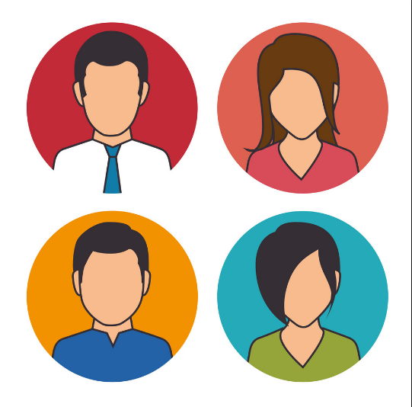
Presentation topics
Overview of Regulation of Lobbying
The Three-Step Test
Registration and return requirements
Contraventions and enforcement
Code of Conduct
Post Employment – Section 22
Section 22 – Case Study
Questions

Slide 3
Regulation of Lobbying Act 2015
Independent lobbying registrar – Standards Commission
Registration of lobbyists (wide ranging scope)
Regular submission of returns (3 x/year)
Web-based public registry (lobbyist, lobbied, subject, intended result)
Post-employment restrictions for some public officials
Investigation and enforcement provisions (compliance focus)
Legislative review mechanism
Notes:
Independent lobbying registrar – Standards Commission
Registration of lobbyists (wide ranging scope)
Regular submission of returns (3 x/year)
Web-based public registry (lobbyist, lobbied, subject, intended result)
Post-employment restrictions for some public officials (one year cooling off period in which they cannot lobby)
Only apply to Ministers, Ministers of state, special advisers and civil service
INCLUDES local authority management (CE, Director of Service and Head of Finance in all local authorities; also includes Assistant Chief Executive and Head of Human Resources in Dublin City Council).
DOES NOT INCLUDE elected officials (local councillors)
Investigation and enforcement provisions (compliance focus)
Legislative review mechanism

Slide 4
What is lobbying? The Three-Step Test
Communication must meet the “three step test” to be considered lobbying - communication by:
Persons within the scope of the Act
With Designated Public Officials
On relevant matters
Act makes no distinction regarding method, venue or formality of communication
Mail, telephone, in-person, electronic, social media
Office, social setting, casual encounter, other

Slide 5
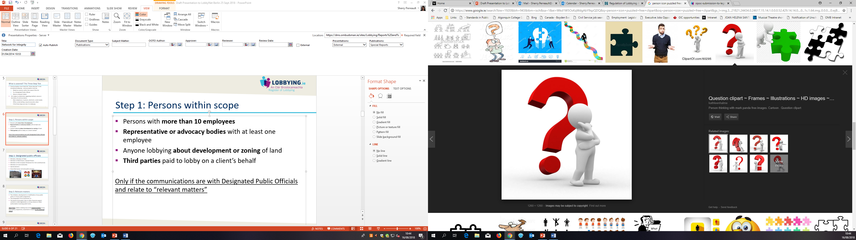
Step 1: Are you within scope of the Act?
Persons with more than 10 employees
Representative or advocacy bodies with at least 1 employee
Third parties paid to lobby on a client’s behalf
Anyone lobbying about development or zoning of land
But even if these criteria are met there is a need to register only if the communications are with Designated Public Officials (DPOs) and relate to “relevant matters”

Slide 6
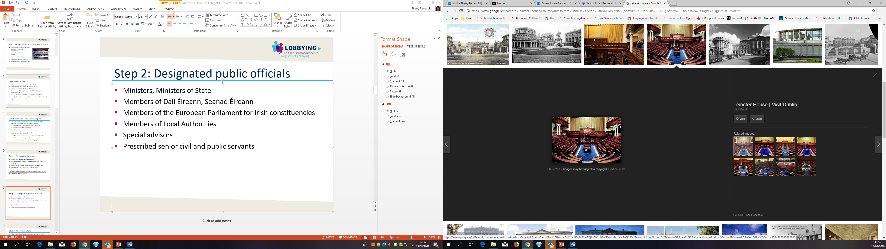
Step 2: Are you communicating with a DPO?
Ministers, Ministers of State
Members of Dáil Éireann, Seanad Éireann
Irish Members of the European Parliament
Members of Local Authorities
Special Advisors
Senior Civil and Public Servants
Civil service: Secretaries General, Assistant Secretaries, Director grades and equivalent
Local authorities: Chief Executives , Directors of Service, Heads of Finance, Head of HR (Dublin City Council)
The Minister may expand group in future (public bodies or levels)

Slide 7
Step 3: Is it about a relevant matter?
The initiation, development or modification of any public policy or of any public programme
The preparation of an enactment
The award of any grant, loan or other financial support, contract or other agreement, or of any licence or other authorisation involving public funds.
Not a relevant matter: Matters relating only to the implementation of any such policy, programme, enactment or award or matters of a technical nature

Slide 8
Exemptions (section 5(5))
Several types of communications are exempt from the requirement to register:
Private affairs
Principal private residence
Diplomatic context
Between public officials
Strictly factual information
Trade union negotiations
Threat to life or safety
Security of the State
Shareholder of State body
Within proceedings of Oireachtas Committee
Information requested and published by public body (Consultations)
Groups established by Public Body where Transparency Code applies (Task forces. Working groups)

Slide 9
Registration requirements
Register after first communication with DPO
Create an account on Lobbying.ie
Include in registration:
Organisation Name - option to include “trading as” name if different from legal name.
Business address and contact details
Main business activities
Identify person with primary responsibility for lobbying
Company Registration Office Number or Charitable Registration Number

Slide 10
Return requirements
3 Returns periods per year with mandatory deadlines
1 September–31 December: returns due 21 January
1 January–30 April: returns due 21 May
1 May–31 August: returns due 21 September
Nil returns are also required
One return per subject - include following information:
Who was lobbied
Subject matter/intended results
Type and extent of activity
Current/former DPOs lobbying for you
Client information (if relevant; lobbyist)

Slide 11

Contraventions and Enforcement
Contraventions of Act:
Lobbying without registering
Failure to submit return by deadline (including nil return)
Providing inaccurate/misleading information
Failing to comply with an investigation
Obstructing an investigation
Consequences of non-compliance
Fixed payment notices for late returns: €200
Investigation and prosecution of contraventions
If convicted: higher fines and/or imprisonment

Slide 12
Code of Conduct
Eight Principles of Code:
1) Demonstrate respect for public bodies
2) Act with honesty & integrity
3) Ensure accuracy of Information
4) Disclose identity and purpose
5) Preserve confidentiality
6)Avoid improper influence
7) Observe provisions of Act
8) Observe provisions of code
Came into effect 1 January 2019
Purpose to govern behaviour – ensure lobbying ethical
Sets out 8 key principles
Persons lobbying should have regard to Code

Slide 13
Section 22- Post-employment restrictions
Provides that specific categories of Designated Public Officials ("DPOs") are subject to a one-year “cooling-off” period, during which;
they cannot engage in lobbying activities in specific circumstances,
or be employed by, or provide services to, a person carrying on lobbying activities in specific circumstances.
Purpose:
To manage the potential for conflicts of interest between the public and private sectors,
To place restrictions on what is often referred to as a “revolving door” between the public and private sector.

Slide 14
Section 22- Relevant DPOs
Does not include all Designated Public Officials.
Includes:
Ministers of the Government and Ministers of State.
A special adviser appointed under section 11 of the Public Services Management Act 1997.
A public servant prescribed as a DPO by the Minister for Public Expenditure, NDP Delivery and Reform (Defined list)

Slide 15
Section 22 - Scope
Involves any public service body with which the relevant DPO was connected, that is, employed or held an office or other position in the year prior to his/her leaving
Lobbying a person, who was also a DPO, who was employed by or held an office or other position with that public service body in the year prior to the relevant DPO’s leaving (a “connected DPO”).

Slide 16
Section 22- Determination
The Commission may make a determination on an application for consent after any appropriate consultation. The Commission may:
Give the person consent without conditions;
Give the person consent with specific conditions attached; or
Refuse consent.

Slide 17
Section 22 - Post employment Case Study
Special advisor sought consent to take up a position with an employer registered on the Register of Lobbying.
Requested to waive full 12 months of cooling off period.
Proposed employer confirmed the applicant would not be required to carry out any lobbying activities in the role.
However, they had previously reported that they had directly lobbied the applicant.
The Commission took into account that the applicant was seeking to commence employment with a registrant who had recently and directly lobbied the applicant and the Government department.

Slide 18
Section 22 - Post employment Case Study
A number of returns submitted by the registrant named the department and the applicant in relation to the communication.
The Commission also took into account that the applicant had been offered the position without a competitive process and seemed to have been head-hunted by the registrant.
The employer informed the Commission that it anticipated continuing to lobby the department during the applicant’s cooling-off period on some of the same subject matters on which the applicant had been lobbied.

Slide 19
Section 22 - Post employment Case Study
The Commission considered that the registrant would almost certainly benefit from the applicant’s connections and knowledge gained during the applicant’s time as a designated public official.
The Commission considered that this was exactly the type of situation that the provisions of section 22 of the Act are intended to regulate.
Regulating the ‘revolving door’.

Slide 20
Section 22 - Post employment Case Study
Having regard to the applicant’s previous and proposed roles, the Commission did not consider that the objectives of section 22 of the Act, or the public interest, would be served by waiving the cooling-off period as requested, and refused the application.
The applicant appealed the Commission’s decision. The appeal was referred to an independent appeal officer and was upheld.
The appeal officer’s decision was not appealed to the High Court.

Slide 21
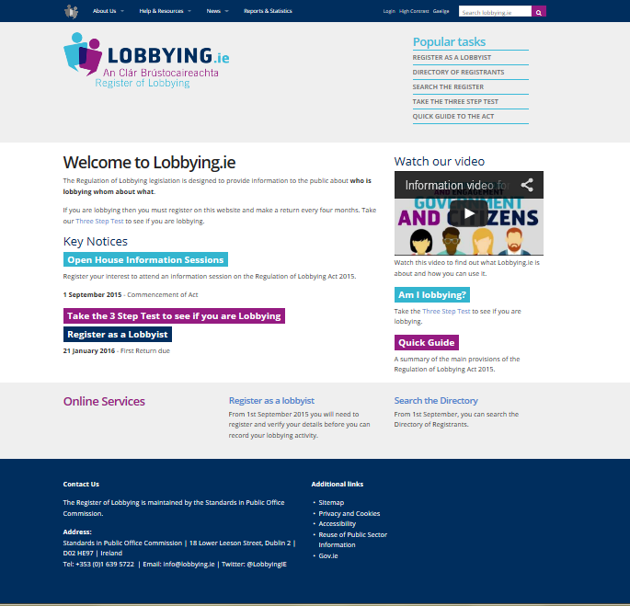
Thank you/Questions?
Visit our website:
www.LOBBYING.ie
Notes:
QUESTIONS?

